Slide 1

Department of Computer Science and Engineering
Course Code : 18CSS84
PROJECT PHASE 2 REVIEW 1 PRESENTATION
ON
CROSSOVER RECOGNITION OF LUNG INFECTIONS USING CHEST X-RAY IMAGES UTILIZING CNN
Guided by:
PROF. VISHESH J
Assistant Professor
Department of CSE
Presented by:
LIKHITHA B H : 1DB19CS080
NEHA R RAO : 1DB19CS095
RUCHITHA M : 1DB19CS165
LATHARANI : 1DB20CS405

Slide 2
AGENDA
INTRODUCTION
LITERATURE SURVEY
PROBLEM STATEMENT
OBJECTIVES
METHODOLOGY
SYSTEM DESIGN
REFERENCES

Slide 3

INTRODUCTION
At first, the COVID-19 outbreak was declared by Wuhan, China in December 2019 which was highly widespread by March 2020.
Early detection of COVID-19, pneumonia and lung cancer is critical for curative therapy and increasing survival rates. There is also a chance that the diagnosis of these diseases could return a false positive result.
The aim of this study is to simplify the process of detecting the COVID-19 and pneumonia using the concept called CNN (Convolutional Neural Network).
In this we will extract out the features from the images, which will lead the foundation for distinguishing between the different lung diseases, and then those extracted feature set would pass through the classifier for the prediction.

Slide 4
LITERATURE SURVEY
SL NO. | AUTHOR | TITLE | PUBLISHED YEAR | BRIEF DESCRIPTION
1. | Kanakaprabha.S, et.al,[ | Analysis of COVID-19 and Pneumonia Detection in Chest X-Ray Images using Deep Learning | 2021 | The proposed work aims to detect the Normal lungs, COVID19 Infected lungs, Pneumonia Infected lungs from the X-Ray images.
2. | Afonso U. Fonseca, et.al,[ | Screening of Viral Pneumonia and COVID-19 in Chest X-ray using Classical Machine Learning. | 2021 | A study to explore classic machine learning methods for the automatic detection of COVID-19 pneumonia cases from CXR images.
3. | Mohammad Farukh Hashmi, et.al | Efficient Pneumonia Detection in Chest Xray Images Using Deep Transfer Learning | 2020 | The proposed methodology uses a deep transfer learning algorithm that extracts the features from the X-ray image that describes the presence of disease automatically and reports whether it is a case of pneumonia.

Slide 5
LITERATURE SURVEY
SL NO. | AUTHOR | TITLE | PUBLISHED YEAR | BRIEF DESCRIPTION
4. | Saeed S. Alahmari, et.al, | A Comprehensive Review of Deep Learning-Based Methods for COVID-19 Detection Using Chest X-Ray Images. | 2022 | This review paper summarizes deep learning approaches for COVID-19 detection using chest X-ray images and provide potential improvements for higher accuracy.
5. | Vinod Kumar, et.al, | Detection system for lung cancer based on neural network: X-Ray validation performance. | 2013 | In this paper, the author developed a lung cancer detection system for early detection of lung cancer by studying lung Xray images using number of steps.

Slide 6

PROBLEM STATEMENT
Deep learning has advanced medical image segmentation, providing powerful diagnostic tools.
Early detection of COVID-19 is crucial, making this technology even more important.
Hence, an image classification model is built to detect and categorize the chest X- Ray images into Normal, Pneumonia, COVID-19 and Lung Cancer using chest X Ray images in CNN.
Existing Systems doesn’t accurately categorize the covid, pneumonia and lung cancer accurately.
In the proposed system, features of the lungs are extracted and is used to increase the resolution and efficiency level of a given input aiding in the differentiation of the lung diseases.

Slide 7

OBJECTIVES
The Main objective of the project is to detect Lung diseases in patients using Chest X-Ray Images through the following steps:
Upload X-Ray Images - The system should be capable of getting X-Rays from users that will be utilized by the Model.
Detection of Hybrid Model - The system should be able to detect the COVID-19, Pneumonia and Lung Cancer within the X – Ray images that users have uploaded.
Display Results - The system should be able to give information that the user can appropriately understand and gain insight from it.

Slide 8

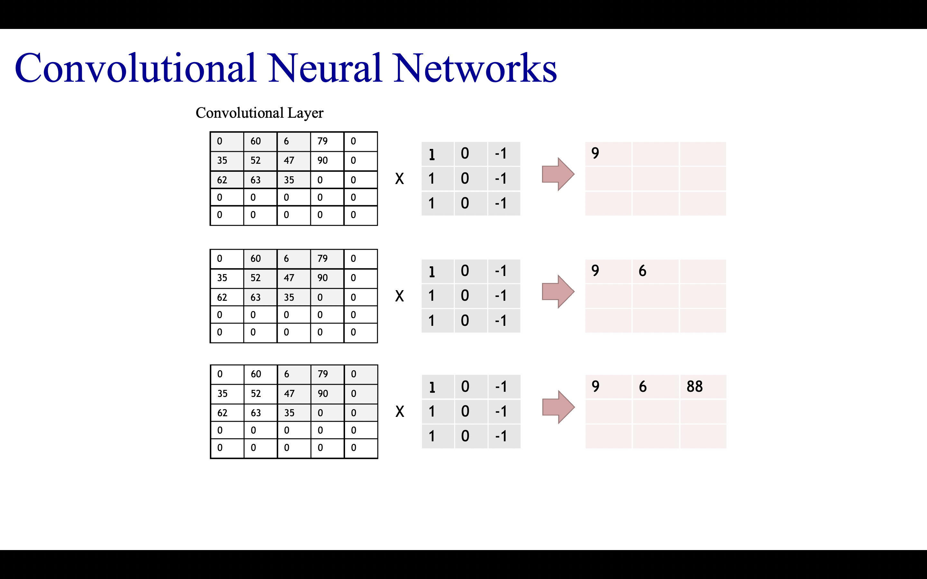
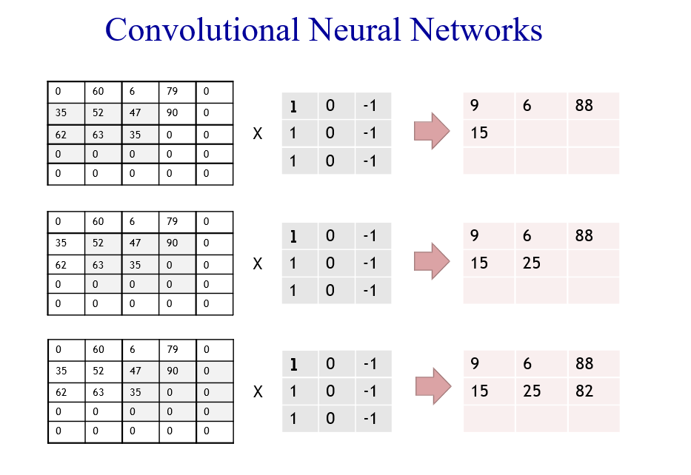
METHODOLOGY

Slide 9
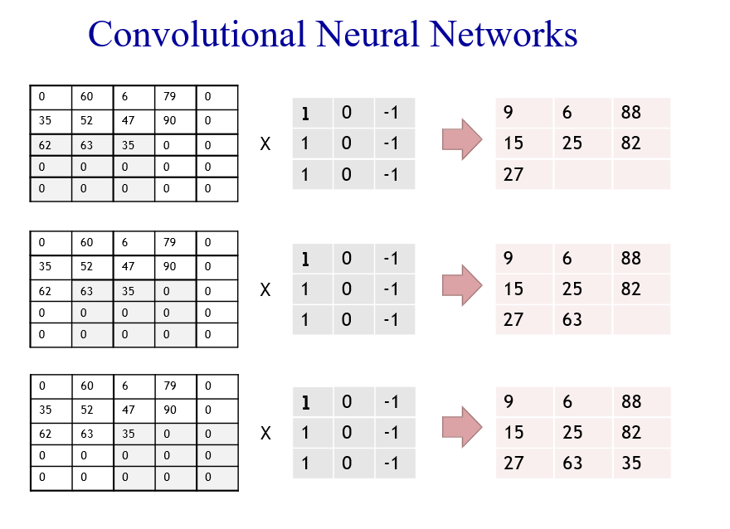
METHODOLOGY

Slide 10
METHODOLOGY
9 | 6 | 88
15 | 25 | 82
27 | 63 | 35
Convolutional Output: A 3*3 matrix
Convolution is followed by the rectification of negative values to 0s, before pooling. Here, it is not demonstratable, as all values are positive. In fact, multiple iterations of both are needed before pooling.
9 | 6 | 88
15 | 25 | 82
27 | 63 | 35
25 | 88
63 | 82
25
88
63
82
THE FULLY
CONNECTED
LAYER
Pooling Layer [MAX POOL]
Pooled Output:
A 2*2 matrix
Flattened Matrix

Slide 11
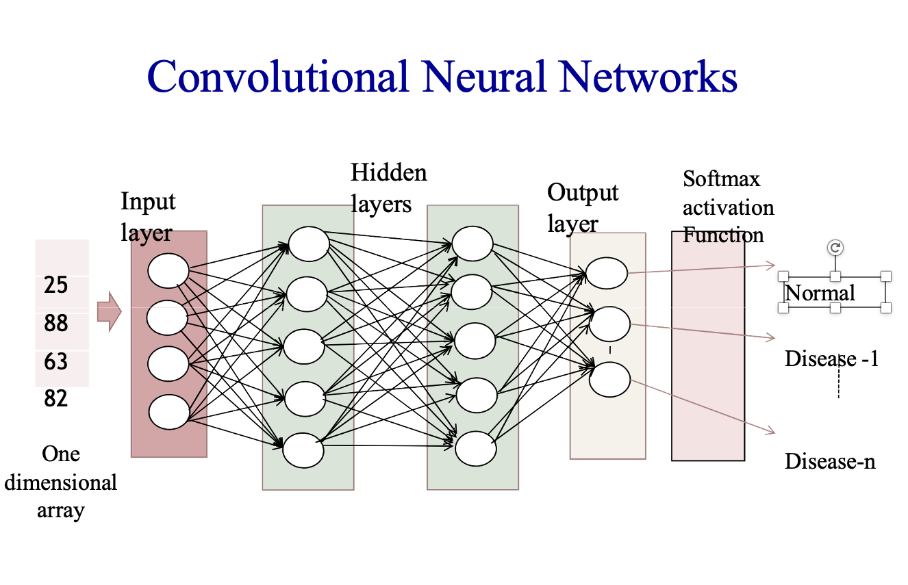
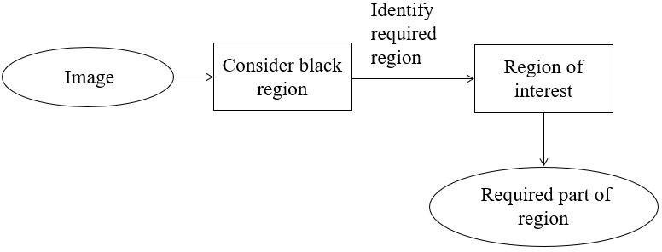
METHODOLOGY
DATA FLOW DIAGRAM FOR IDENTIFICATION

Slide 12
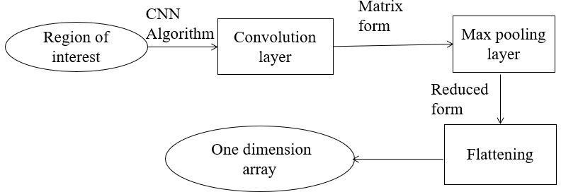
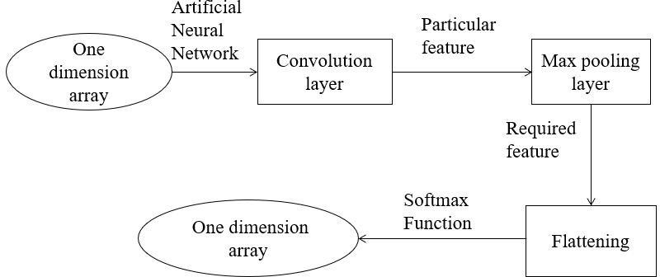
METHODOLOGY
DATA FLOW DIAGRAM FOR FEATURE EXTRACTION
DATA FLOW DIAGRAM FOR CLASSIFICATION AND DETECTION

Slide 13

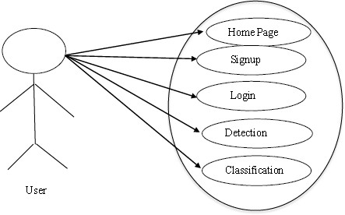
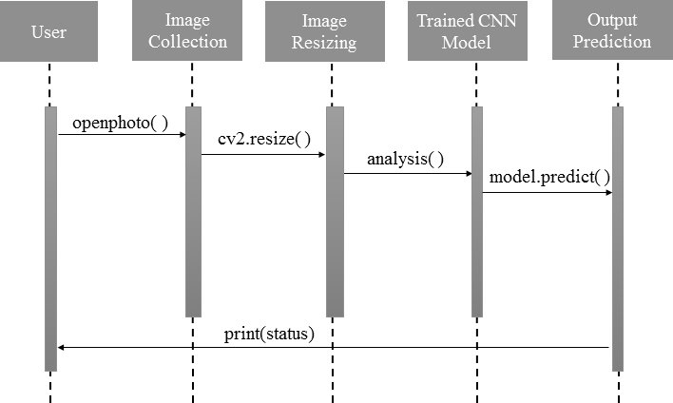
SYSTEM DESIGN
USE CASE DIAGRAM
SEQUENCE DIAGRAM

Slide 14
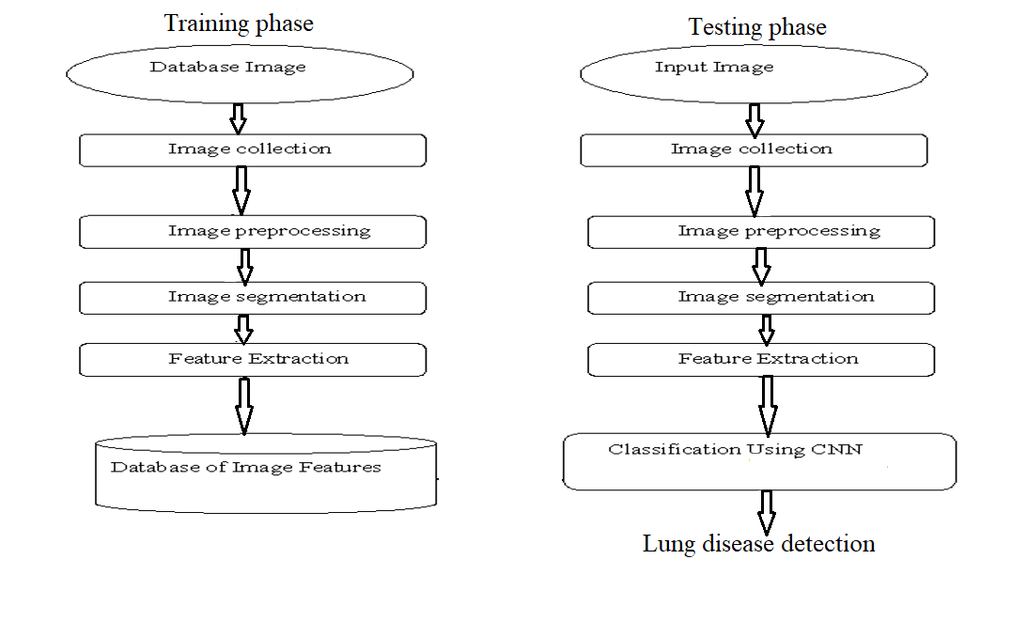
SYSTEM DESIGN
SYSTEM ARCHITECTURE

Slide 15
REFERENCES
Kanakaprabha. S., D. Radha. (2021). Analysis of COVID-19 and Pneumonia Detection in Chest X-Ray Images using Deep Learning.
Afonso U. Fonseca, et.al,(2021). Screening of Viral Pneumonia and COVID-19 in Chest X-ray using Classical Machine Learning.
Mohammed Farukh Hashmi, et.al, (2020). Efficient Pneumonia Detection in Chest Xray Images Using Deep Transfer Learning.
Saeed S. Alahmari, et.al,(2022). A Comprehensive Review of Deep Learning-Based Methods for COVID-19 Detection Using Chest X-Ray Images
Vinod Kumar, et.al,(2013). Detection system for lung cancer based on neural network: X-Ray validation performance.

Slide 16
THANKS!

